Slide 1

Department of Information Technology
A.P. Shah Institute of Technology
G.B.Road,Kasarvadavli, Thane(W), Mumbai-400615
UNIVERSITY OF MUMBAI
Academic Year 2020-2021

Slide 2
A Project Report on
An Interactive Web Framework to Know Your Foot Health
Submitted in fulfillment of the degree of
Bachelor of Engineering(Sem-8)
in
INFORMATION TECHNOLOGY
By
Abhishek L. Pote:17104073
Abhishek A.P. Rai:17104027
Tanmay S. Rajadhyaksha:17104025
Under the Guidance of
Dr. Sameer Nanivadekar

Slide 3
1.Project Conception and Initiation

Slide 4
1.1 Abstract
In today’s modern era people are suffering from many acute conditions and diseases which are never heard of many a times people also get joints pain or fractures due to some disease or accidents happening eventually, considering your legs as vital function in your day today activities it's really important and sensitive to take care of foot problems one might be facing due to any accident or disease.

Slide 5
1.1 Abstract
For such conditions which are severe and should be brought into light for treatment is one of the purpose the company to develop the website which will post information related to foot conditions, symptoms, treatment and prevention which will be medically reviews by physiotherapists and then will be uploaded to this website to make people aware of possible injuries to be coming and how to avoid them.

Slide 6
1.2 Objectives
To develop a blog and product advertisement website for foot health/physiotherapy product based company.
To develop fully fledged, functional and dynamic website for organization.
To integrate 3D models for demonstration of foot conditions.
To develop remote assessment using 3D model and forms.
To provide with an easy to post content and product advertisement website

Slide 7
1.3 Literature Review
The current websites related to foot health lacks some or other functionality which we will be incorporating inside our website which solely focus on providing foot problems, their symptoms, treatment and prevention alongside with product designed to company to help identify physiotherapists the foot problem one might be facing and coming up with solid solutions to help tackle those problems.
Currently websites providing this information doesn’t have appropriate product to be introduced to patients which will help for their foot treatment while this side will be having number of product ranges which will be used by physiotherapists to help tackle the problem.
For instance, consider foot.com where information is introduced on foot conditions which is quiet minimal information to be posted considering a medical condition.

Slide 8
1.3 Literature Review
Also it will be more informative for patients to understand when information will be broken down into much detail by already masters in this field which are the doctors associated with organization who will be providing with much of a detail view and information related to conditions and also accurate treatments or prevention’s to be posted.
This website would also include the product, it’s use and nearby physiotherapists to users location which use this technology to treat their patients.

Slide 9
1.3 Literature Review
The proposed 3D models in can be used to integrate in website for foot conditions but we will try to incorporate our 3D foot model which will be interactive and responsive and will also give information regarding the pain area on model which will be responsive as user clicks on foot region where he/she feels pain and then it will pop up with the article showcasing what kind of condition it is and may redirect to related article where its cause, treatment and prevention must be posted Embedding 3D models inside website will not only help in better understanding but also will give a broad overview about what can possibly happen when one ignores the foot conditions they might be facing.

Slide 10
1.4 Problem Definition
The development of foothealth website is considered regarding the increasing foot pain conditions ,symptoms and treatments regarding foot.
Normal patients as well as athletes suffer a lot of foot injuries which gets worsen with time because of improper attention or treatment and ignoring behaviour towards the condition. Even the shoes you wear if are not comfortable to you can cause foot injuries or fractures which can sustain lifetime.
For such conditions which are severe and should be brought into light for treatment is one of the purpose the company to develop the website which will post information related to foot conditions, symptoms, treatment and prevention which will be medically reviews by physiotherapists and then will be uploaded to this website to make people aware of possible injuries to be coming and how to avoid them.

Slide 11
1.5 Scope
One may face problem recognizing the causes of their foot problems ,the symptoms associated with them and also possible treatment which might help solve foot problems.
Many a times wearing wrong fit shoes or footwear can cause some serious heel and forefoot pain which only gets worsen by time if not treated.
For this we are developing foothealth a website which will brief many patients regarding their conditions, symptoms and possible treatment.

Slide 12
1.6 Technology stack
Django
MySql
HTML
JavaScript
CSS
Editor
Three.js

Slide 13
1.7 Benefits for environment & Society
Our website can help those people who are suffering from foot pain or diabetes through the articles and blogs uploaded in the website which is verified by the professional Physiotherapist.
With implementation of 3d model UI in our website any user can understand the issues related to his or her health and the awareness about that foot health issues can be created by knowing about that that issue with the help of our website.

Slide 14
2. Project Design

Slide 15
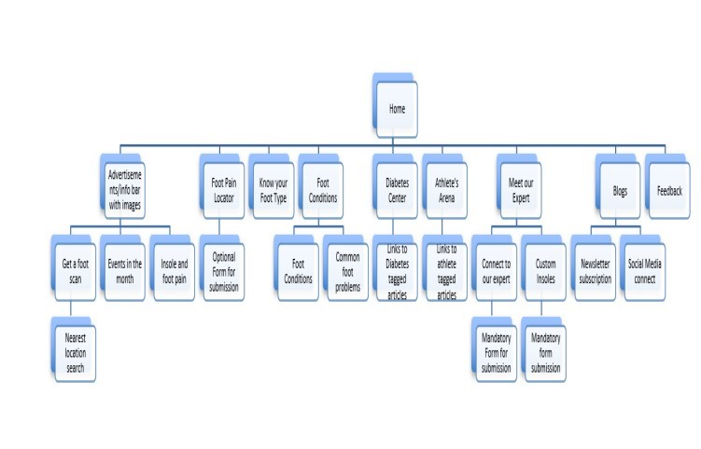
2.1 Proposed System
Linking to pages within the site will be at several places as per individual page layouts for.e.g. Get a foot scan would appear as a banner(link) on many pages
External links to Amazon, Flipkart, social media may also appear as banners/buttons and links to them
External links to Stepp test or OHm3000 (www.ohmsmat.com) can also be provided

Slide 16
2.1 Proposed System
Administrative panel
Access control
Content manager (CM)
Site administrator (SA)
Access to customer forms, feedback databases (Gen)
Content addition (CM)
Advertising panel(top of home page)
Organization of ads (3/5).
Store all old ads
First to view on opening home page

Slide 17
2.1 Proposed System
Add new articles ( many tags need to be created so that they can be cross referenced)
In foot conditions and common foot problems
In diabetes center
In athletes corner
Add new blog articles
Organization of blog articles (which one first etc)
Edit external links – e-com, social media etc (SA)
Cross linking social media (SA)

Slide 18
2.1 Proposed System
Edit forms, articles and blogs, newsletters (SA)
Edit Images in articles (change) (CM)
Add new branch on home page (SA)
Add new branch on sub pages (SA)
Newsletter service management (Gen)
Security and Privacy policies (SA)

Slide 19
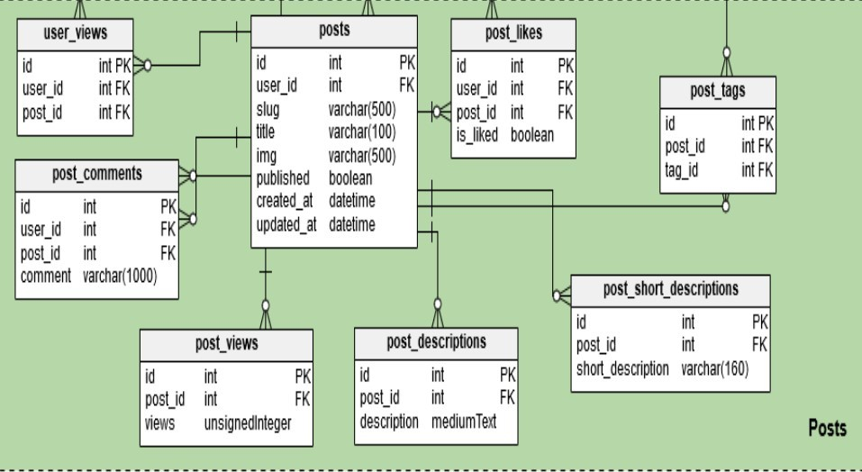
2.1 Proposed System
This fig is a reference database for blogs or articles to be posted on website which includes different constrains for storing post information as well as its retrieval and view to be reflected on site. The whole website database will also be designed subsequently as the website development progresses further.

Slide 20
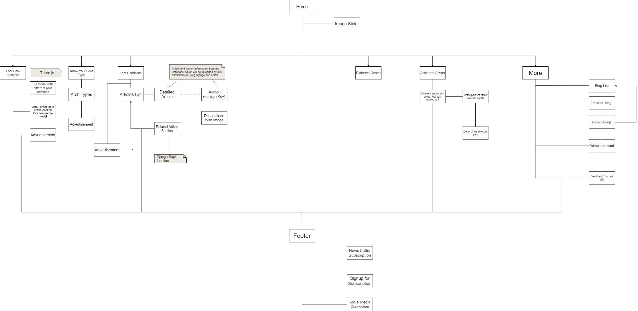
2.2 Design(Flow Of Modules)

Slide 21
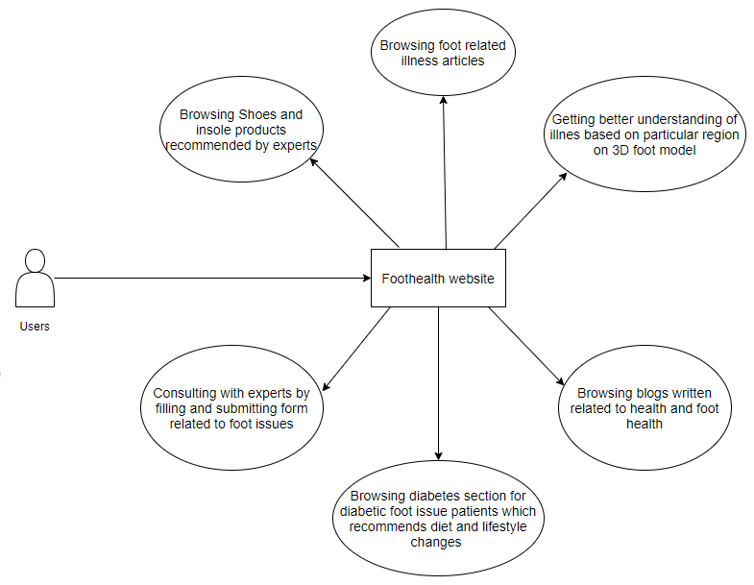
2.3 Description Of Use Case

Slide 22
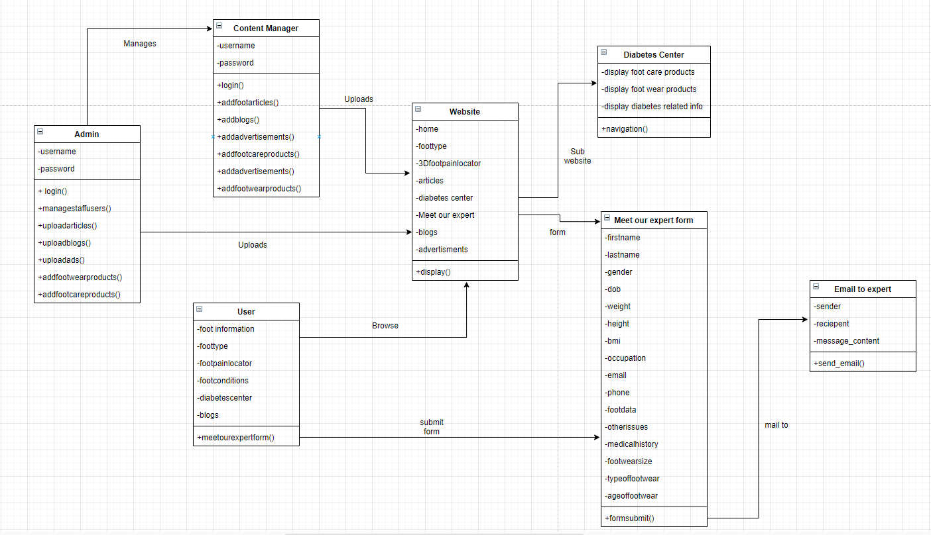
2.4 Class Diagram

Slide 23
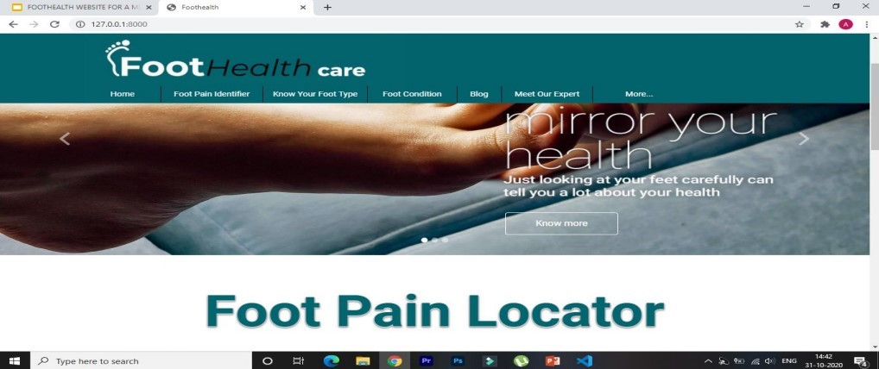
2.5 Module-1
Home Page

Slide 24
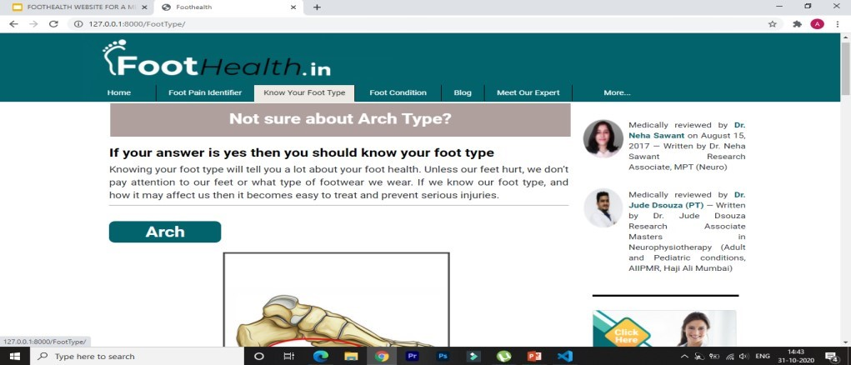
Module-2
Know your foot type page

Slide 25
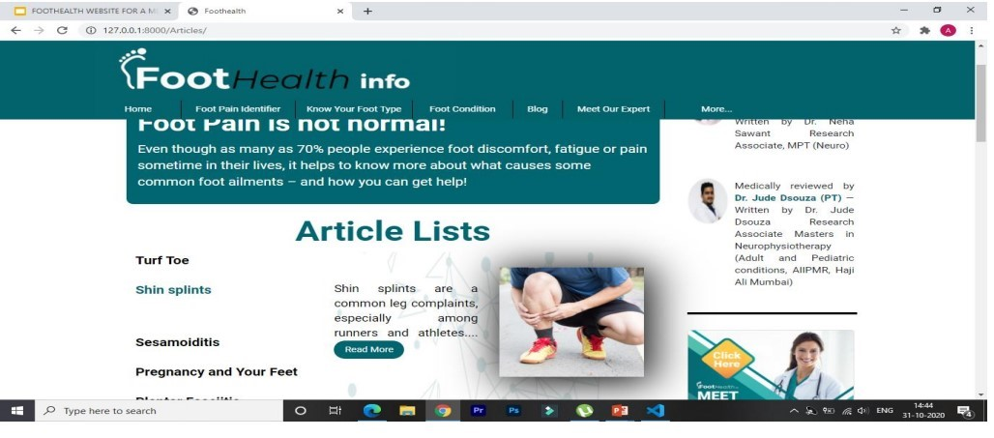
Module-3
Foot Conditions page

Slide 26
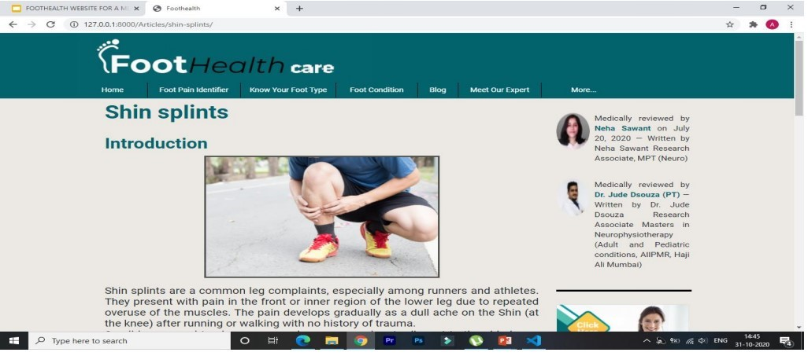
Module-4
Detailed Article page

Slide 27
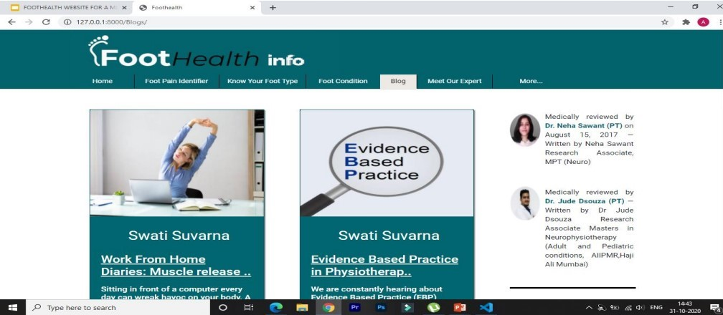
Module-5
Blog List page

Slide 28
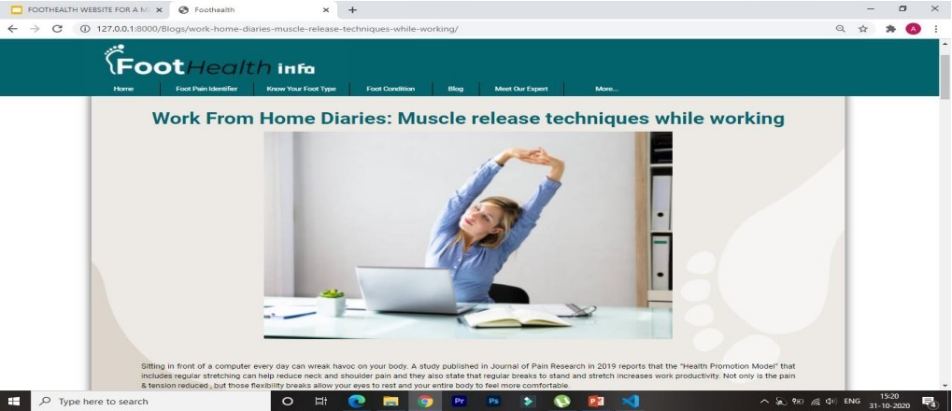
Module-6
Detailed blog page

Slide 29
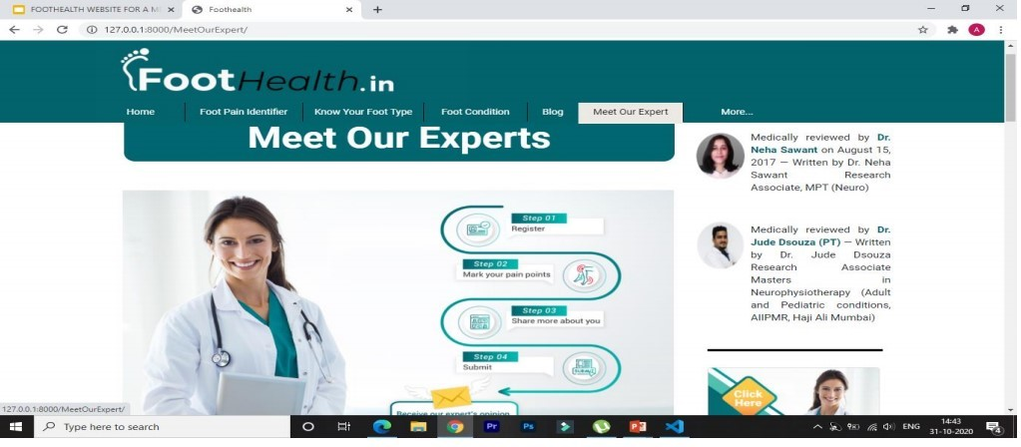
Module-7
Meet our experts page

Slide 30
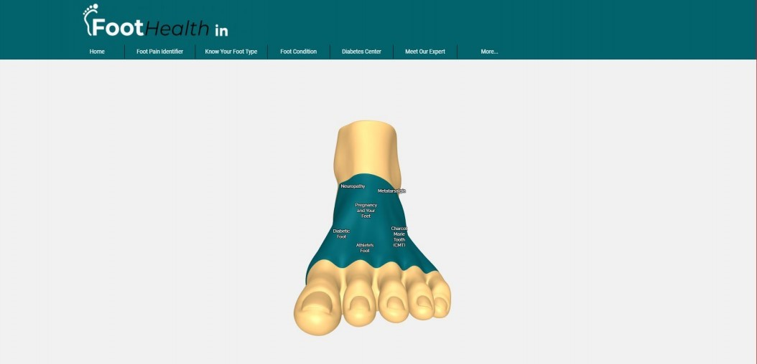
Module-8
Foot pain locator page

Slide 31
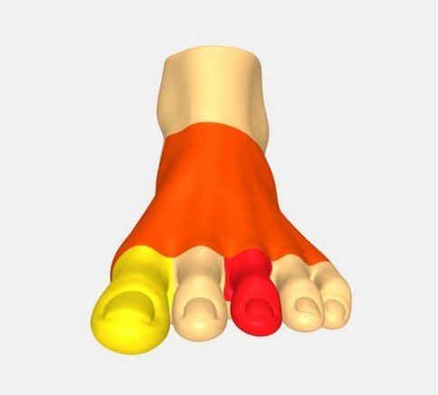
Module-9
Foot Pain regions for form

Slide 32
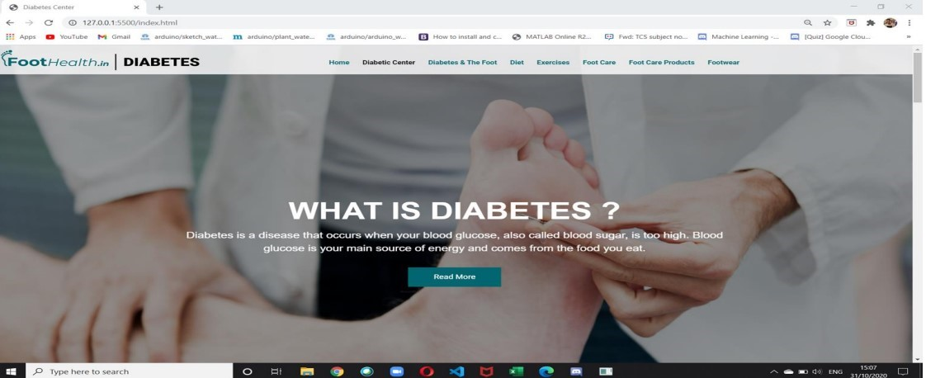
Module-10
Diabetes Center Page

Slide 33
2.6 References
https://www.healthline.com/health/meniscus-tears
https://www.drscholls.com/symptoms-and-conditions/foot/
https://developer.biodigital.com/
https://ckeditor.com/ckeditor-4/
https://threejs.org/

Slide 34
3. Conclusion and Future Scope

Slide 35
Conclusion
With the above proposed technology stack and proposed architecture we can implement this website on the public domain of the company where different users or clients of the company can visit the website for the queries related to their foot health and the company can post the blogs and different articles related to the foot health as a site administrator.Users can get to know about the products of the company through the site.Users can also use self assessment form to get guidance from medical about foot problems.

Slide 36
Thank You

